Slide 1



US Accidents Dashboard (2016 -2020)
DSO 545:
Final Project
For this project, we chose to analyze data on U.S. traffic accidents from 2016 to 2020. Our aim for this project was to identify patterns, reasonings and evidence to suggest where, when and how the accidents have taken place in the U.S. and that could be leveraged for a more informed data-driven decision making. Our analysis was focused on how accidents distribute across various factors based on geographical location, nature of accident, time, season, weather conditions etc. While we weren’t able to find a direct correlation between weather and the amount of accidents, we were able to discover that California and freeways are prime locations for accidents to take place and that daytime (specifically 5 p.m.) is when the majority of these accidents occur. These visualisations and analysis can be utilised by researchers and officials to identify and prioritise the possibilities of severe impact accidents based on road guidelines and external factors.
Notes:
Vaibhav Jha
Hemanth Mallagatta Ravishankar
Suruchi Khetarpal
Hanniyah Bilwani
Aman Agarwal
Neelabh Dubey
Rishabh Makhija

Slide 2
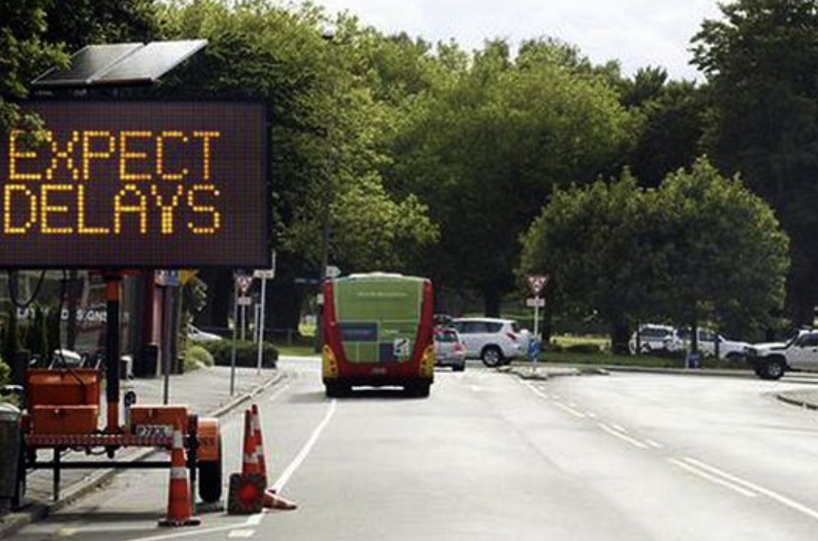

INTRODUCTION
According to the National Highway Traffic Administration, car accidents occur every minute and more than 90 people die in car accidents daily.
Car accidents can be caused by a series of events coming together; speeding, driving under the influence, traffic conditions, etc. While we can’t account for all of these factors, understanding certain factors such as weather conditions and time of day can help reduce the number of accidents or their severity level.
We study a countrywide car accidents dataset, which covers about 49 states of the US. The dataset has records from February 2016 to Dec 2020, collected using APIs that provide streaming traffic incident (or event) data.
Potential End Consumer:
U.S. Department of Transportation, Traffic Safety Administration
Notes:
Aman

Slide 3
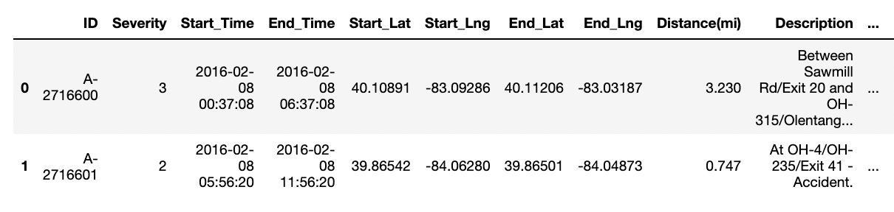
DATA DESCRIPTION
Our dataset is a 4-year compilation of car accidents information across US (2016 to 2020)
1,516,064 rows of accidents data, each row representing a unique car accident
47 columns of information such as ID, Latitude, Longitude, Description, Street, County, State, Severity, Weather, Humidity, Time zone etc.

Slide 4
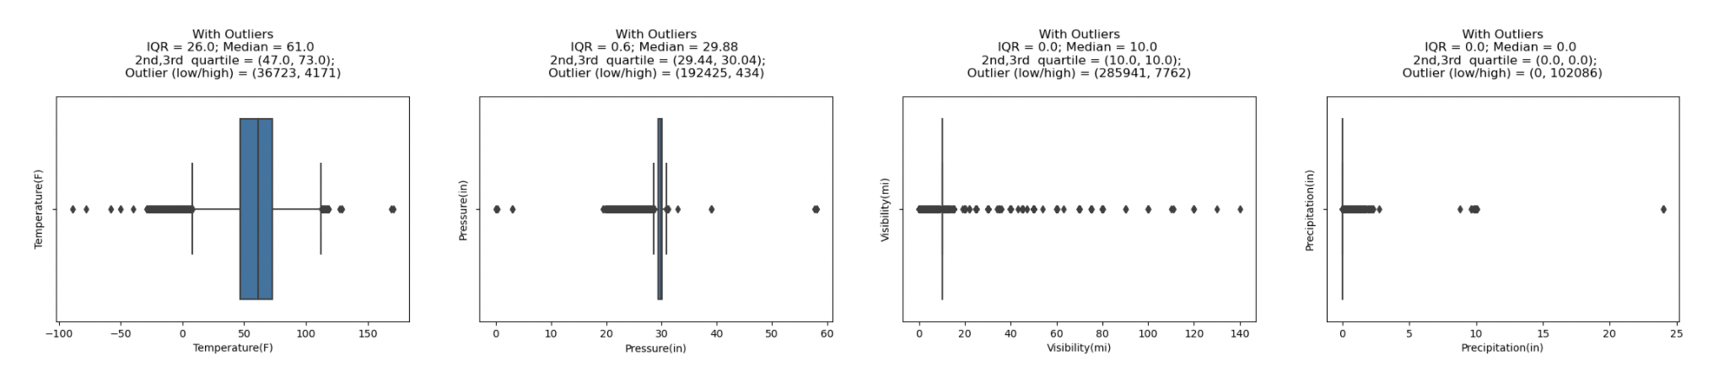
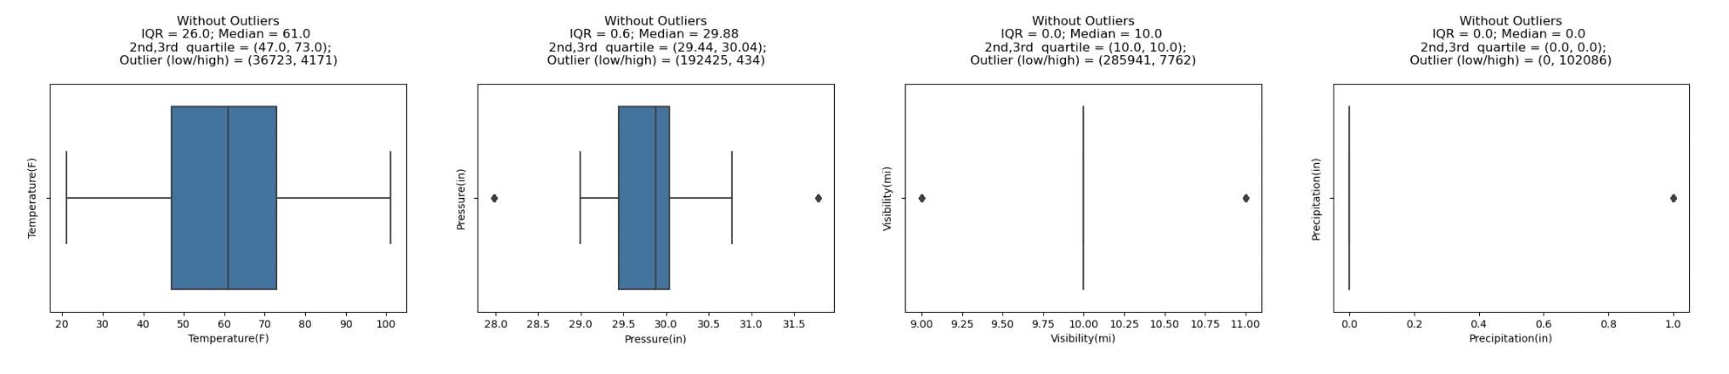
EXPLORATORY DATA ANALYSIS
With Outliers
Without Outliers
Notes:
Sources:
https://www.si.com/wnba/2021/08/26/womens-sports-growth-the-fan-project
https://www2.deloitte.com/xe/en/insights/industry/technology/technology-media-and-telecom-predictions/2021/womens-sports-revenue.html
https://www.un.org/womenwatch/daw/public/Women%20and%20Sport.pdf
https://www.hrw.org/report/2012/02/15/steps-devil/denial-womens-and-girls-rights-sport-saudi-arabia#
Neelabh

Slide 5
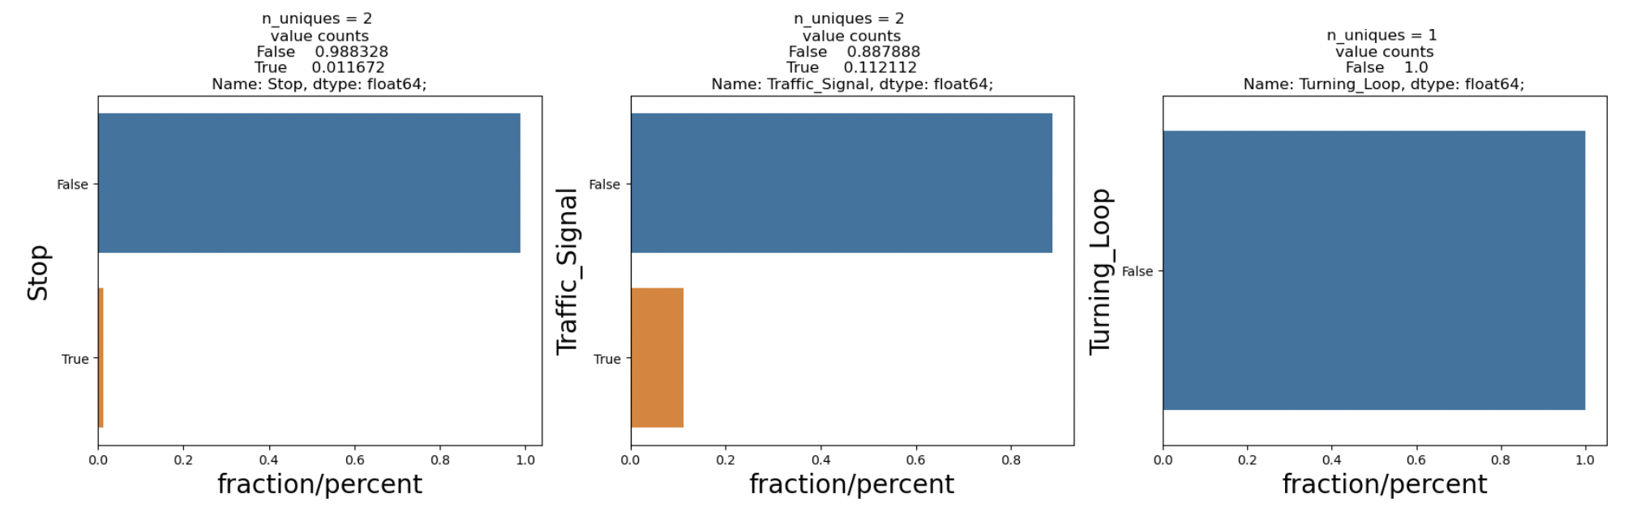
EXPLORATORY DATA ANALYSIS
Notes:
Sources:
https://www.si.com/wnba/2021/08/26/womens-sports-growth-the-fan-project
https://www2.deloitte.com/xe/en/insights/industry/technology/technology-media-and-telecom-predictions/2021/womens-sports-revenue.html
https://www.un.org/womenwatch/daw/public/Women%20and%20Sport.pdf
https://www.hrw.org/report/2012/02/15/steps-devil/denial-womens-and-girls-rights-sport-saudi-arabia#

Slide 6
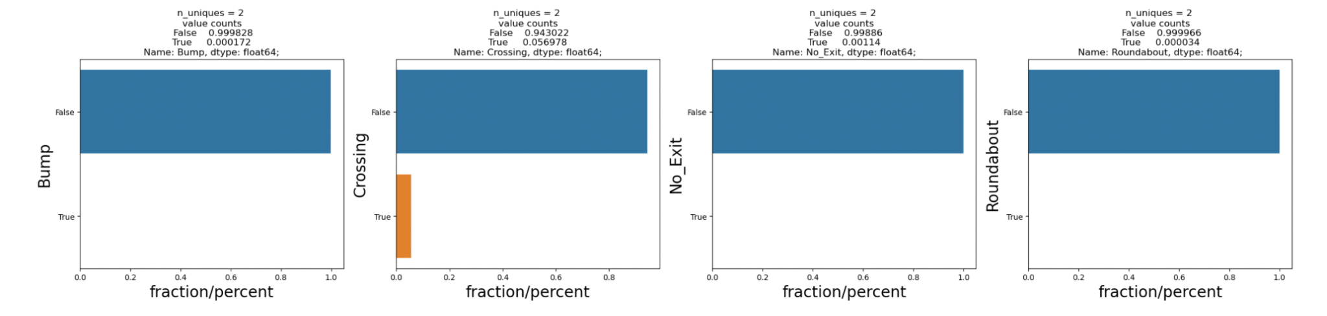
EXPLORATORY DATA ANALYSIS
Notes:
Sources:
https://www.si.com/wnba/2021/08/26/womens-sports-growth-the-fan-project
https://www2.deloitte.com/xe/en/insights/industry/technology/technology-media-and-telecom-predictions/2021/womens-sports-revenue.html
https://www.un.org/womenwatch/daw/public/Women%20and%20Sport.pdf
https://www.hrw.org/report/2012/02/15/steps-devil/denial-womens-and-girls-rights-sport-saudi-arabia#

Slide 7
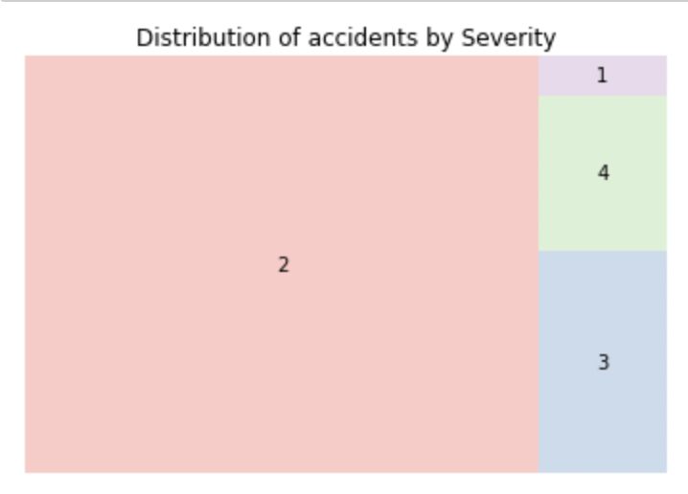
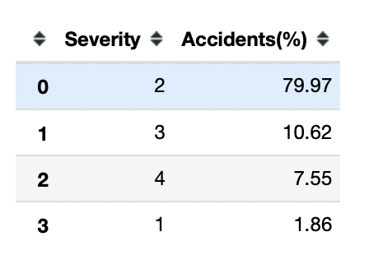
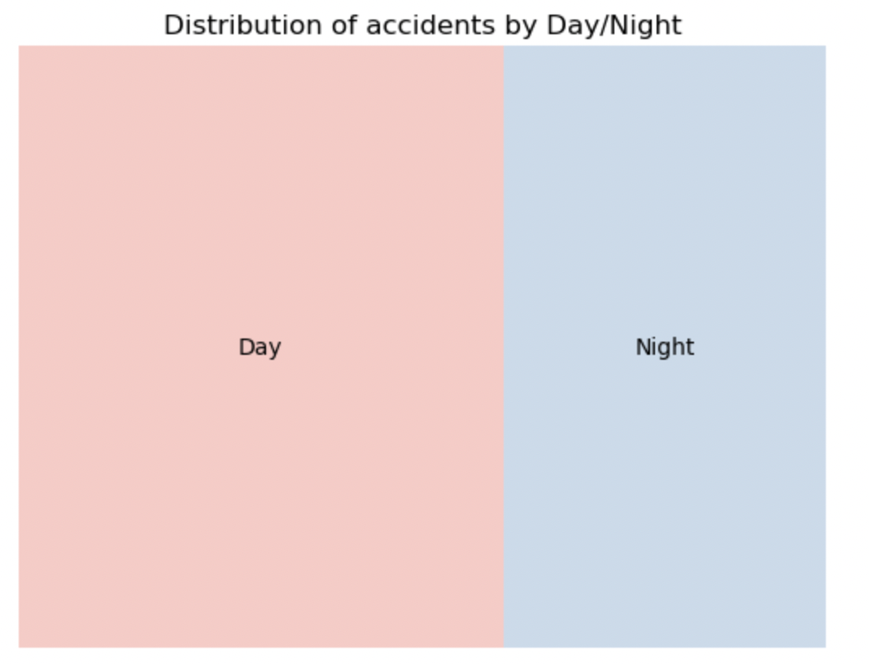
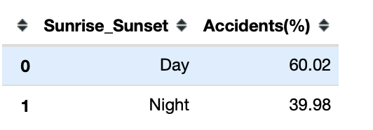
EXPLORATORY DATA ANALYSIS
Almost 80% of the accidents fall under the Category of Severity 2 (Medium- Low Traffic Impact)
Over 60% of the accidents happen in daylight
Notes:
Sources:
https://www.si.com/wnba/2021/08/26/womens-sports-growth-the-fan-project
https://www2.deloitte.com/xe/en/insights/industry/technology/technology-media-and-telecom-predictions/2021/womens-sports-revenue.html
https://www.un.org/womenwatch/daw/public/Women%20and%20Sport.pdf
https://www.hrw.org/report/2012/02/15/steps-devil/denial-womens-and-girls-rights-sport-saudi-arabia#

Slide 8
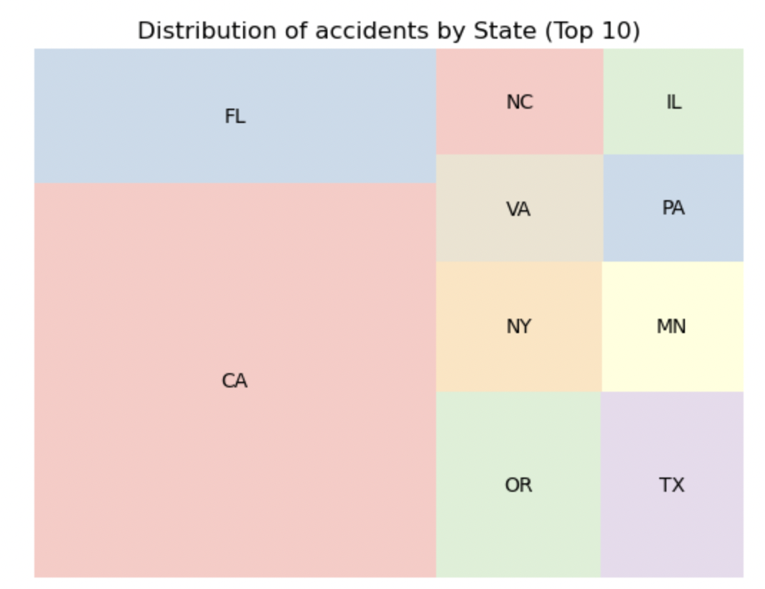
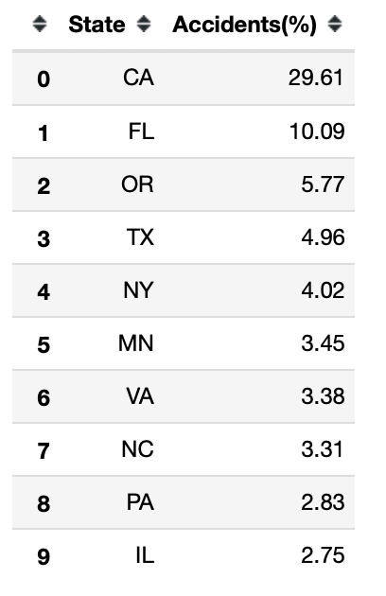
EXPLORATORY DATA ANALYSIS
The above table and Graph shows the Top 10 most accident prone states.
California is the State with the highest proportion of accidents (~30%) - almost 3x of the next most accident prone state i.e. Florida
Notes:
Sources:
https://www.si.com/wnba/2021/08/26/womens-sports-growth-the-fan-project
https://www2.deloitte.com/xe/en/insights/industry/technology/technology-media-and-telecom-predictions/2021/womens-sports-revenue.html
https://www.un.org/womenwatch/daw/public/Women%20and%20Sport.pdf
https://www.hrw.org/report/2012/02/15/steps-devil/denial-womens-and-girls-rights-sport-saudi-arabia#

Slide 9
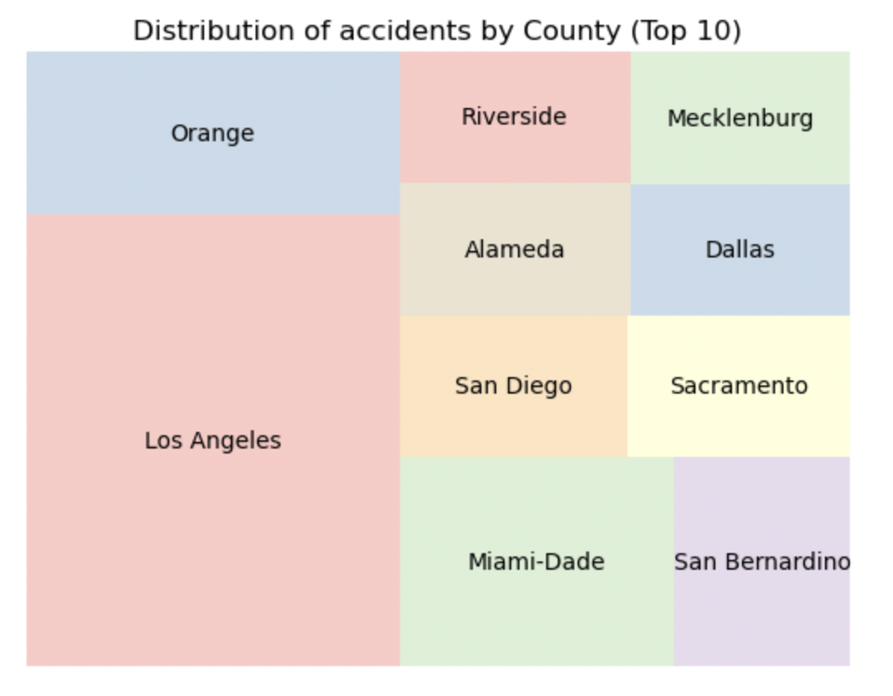
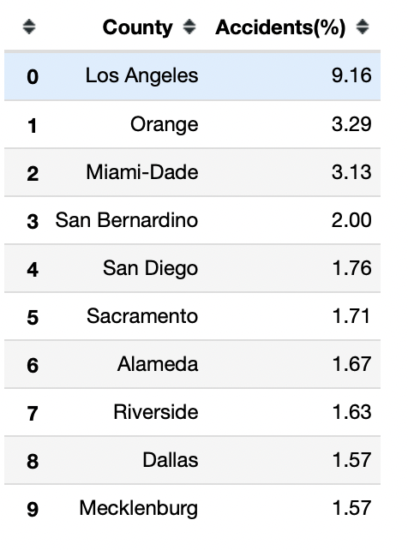
EXPLORATORY DATA ANALYSIS
The above table and Graph shows the Top 10 most accident prone Counties.
An intriguing fact is that 8 out of 10 of the Counties (except Miami-Dade and Dallas) are all located in California State. The Los Angeles county is most accident prone accounting for over 9% of all accidents across US
Notes:
Sources:
https://www.si.com/wnba/2021/08/26/womens-sports-growth-the-fan-project
https://www2.deloitte.com/xe/en/insights/industry/technology/technology-media-and-telecom-predictions/2021/womens-sports-revenue.html
https://www.un.org/womenwatch/daw/public/Women%20and%20Sport.pdf
https://www.hrw.org/report/2012/02/15/steps-devil/denial-womens-and-girls-rights-sport-saudi-arabia#

Slide 10
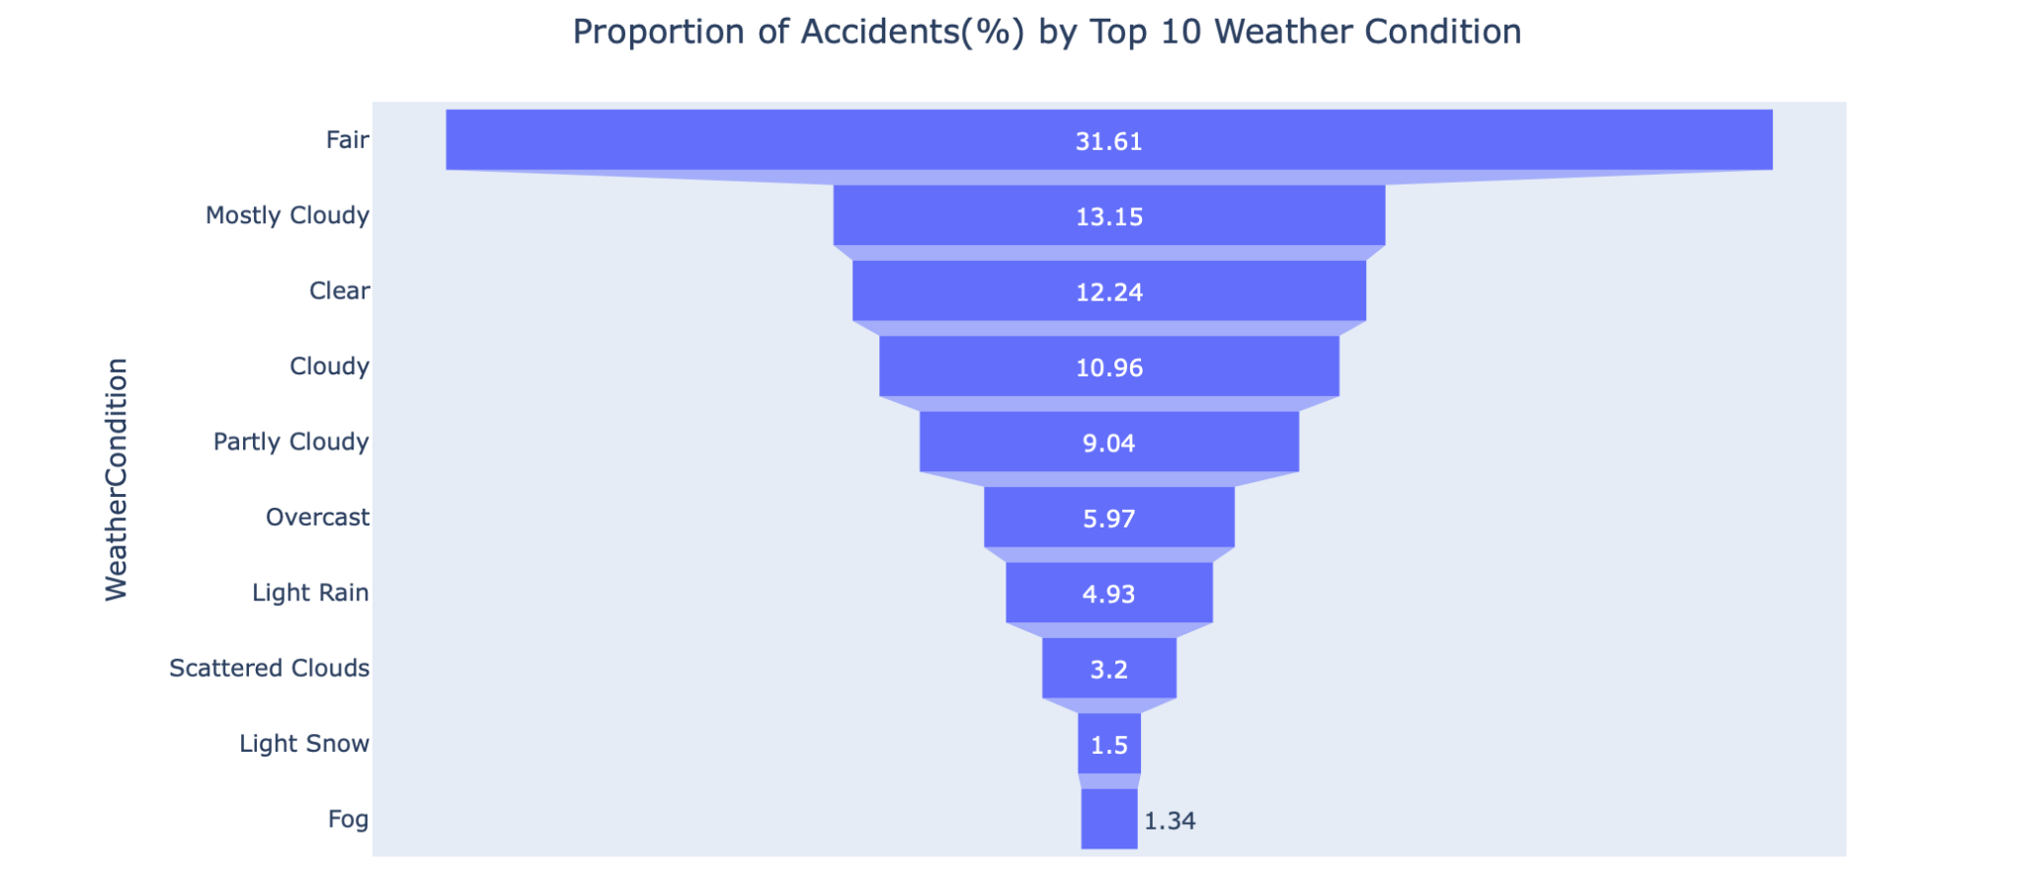
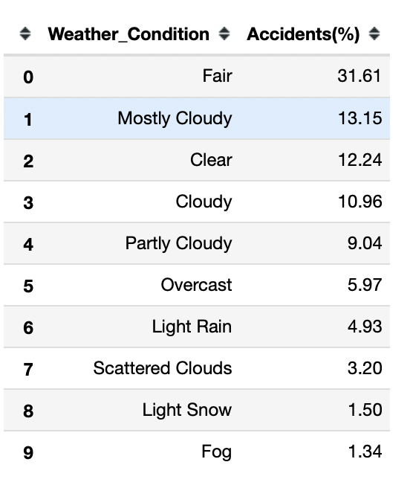
EXPLORATORY DATA ANALYSIS
The above table and Graph shows the proportion of accidents by the Top 10 Weather conditions.
Majority (~32%)of the accidents happen under Fair weather conditions which imply that there are other factors which drive the cause of accidents more than weather
Notes:
Sources:
https://www.si.com/wnba/2021/08/26/womens-sports-growth-the-fan-project
https://www2.deloitte.com/xe/en/insights/industry/technology/technology-media-and-telecom-predictions/2021/womens-sports-revenue.html
https://www.un.org/womenwatch/daw/public/Women%20and%20Sport.pdf
https://www.hrw.org/report/2012/02/15/steps-devil/denial-womens-and-girls-rights-sport-saudi-arabia#

Slide 11
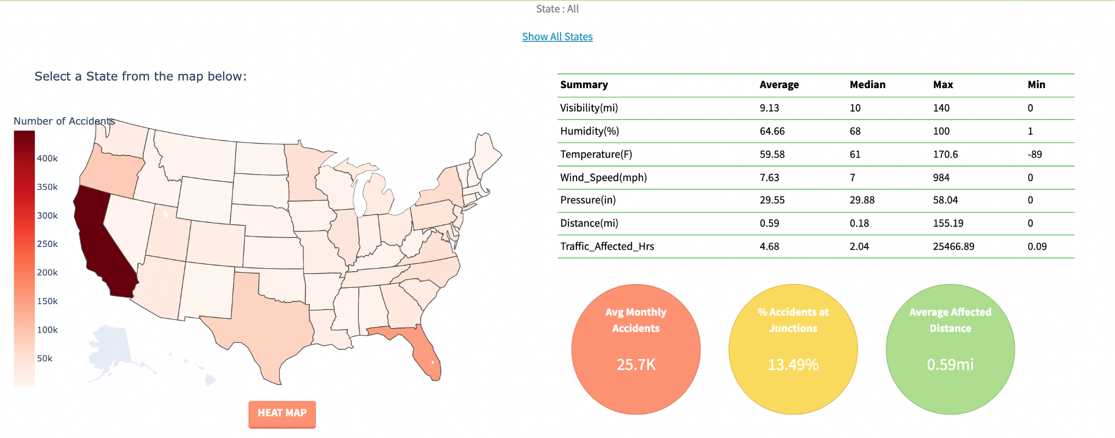
DASHBOARD WALKTHROUGH ( MAP FILTERING, TABLE & KPIS )
Notes:
Sources:
https://www.si.com/wnba/2021/08/26/womens-sports-growth-the-fan-project
https://www2.deloitte.com/xe/en/insights/industry/technology/technology-media-and-telecom-predictions/2021/womens-sports-revenue.html
https://www.un.org/womenwatch/daw/public/Women%20and%20Sport.pdf
https://www.hrw.org/report/2012/02/15/steps-devil/denial-womens-and-girls-rights-sport-saudi-arabia#
Rio 2016 U.S. Olympic Team (U.S. Gender Composition)
https://www.teamusa.org/road-to-rio-2016/team-usa/athletes
USC represented by 44 athletes — most of any U.S. university — at Rio Olympics
https://news.usc.edu/104898/usc-to-be-represented-by-43-athletes-most-of-any-u-s-university-at-rio-olympics/
USC wraps up Olympics with 21 medals, including nine golds
https://news.usc.edu/105935/usc-wraps-up-olympics-with-21-medals-including-nine-golds/

Slide 12
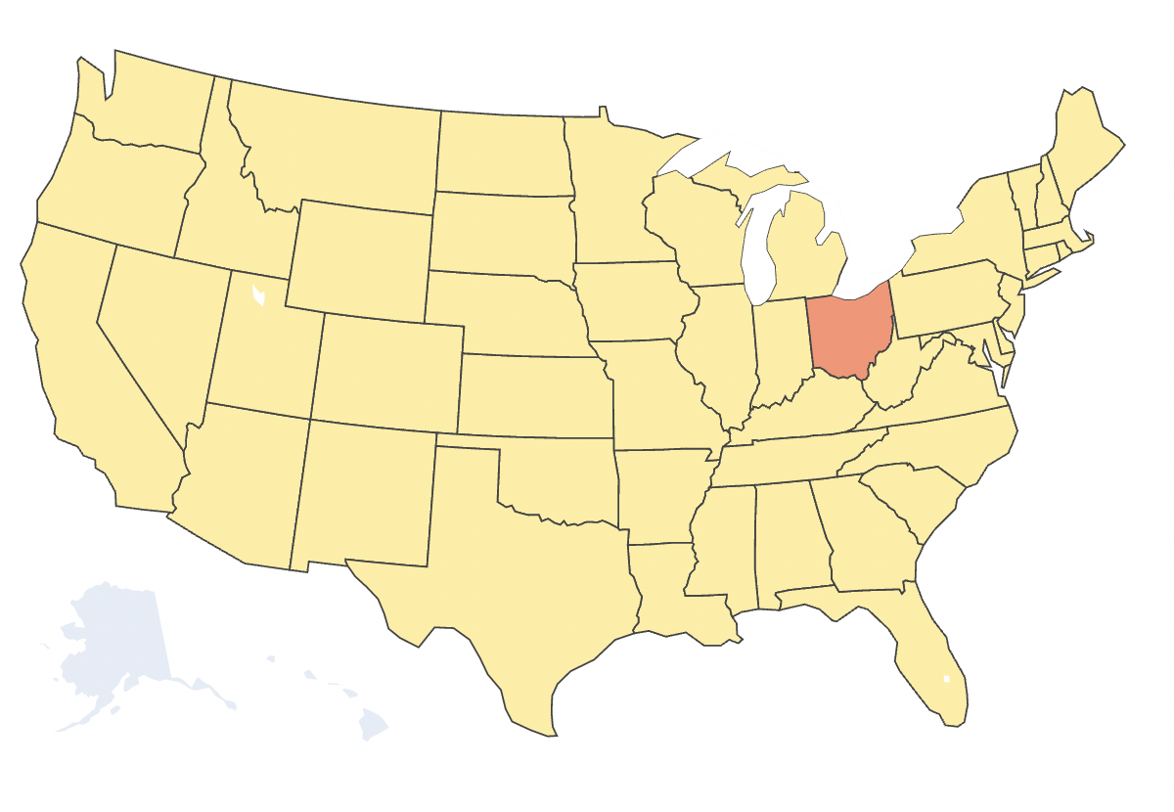
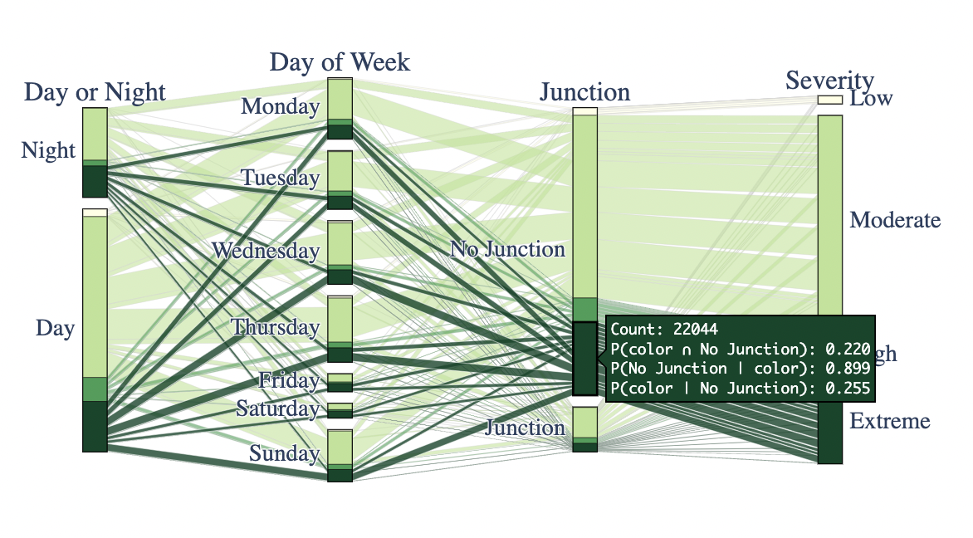
DASHBOARD WALKTHROUGH ( PARALLEL CATEGORIES PLOT )
Notes:
Sources:
https://www.si.com/wnba/2021/08/26/womens-sports-growth-the-fan-project
https://www2.deloitte.com/xe/en/insights/industry/technology/technology-media-and-telecom-predictions/2021/womens-sports-revenue.html
https://www.un.org/womenwatch/daw/public/Women%20and%20Sport.pdf
https://www.hrw.org/report/2012/02/15/steps-devil/denial-womens-and-girls-rights-sport-saudi-arabia#
Rio 2016 U.S. Olympic Team (U.S. Gender Composition)
https://www.teamusa.org/road-to-rio-2016/team-usa/athletes
USC represented by 44 athletes — most of any U.S. university — at Rio Olympics
https://news.usc.edu/104898/usc-to-be-represented-by-43-athletes-most-of-any-u-s-university-at-rio-olympics/
USC wraps up Olympics with 21 medals, including nine golds
https://news.usc.edu/105935/usc-wraps-up-olympics-with-21-medals-including-nine-golds/

Slide 13
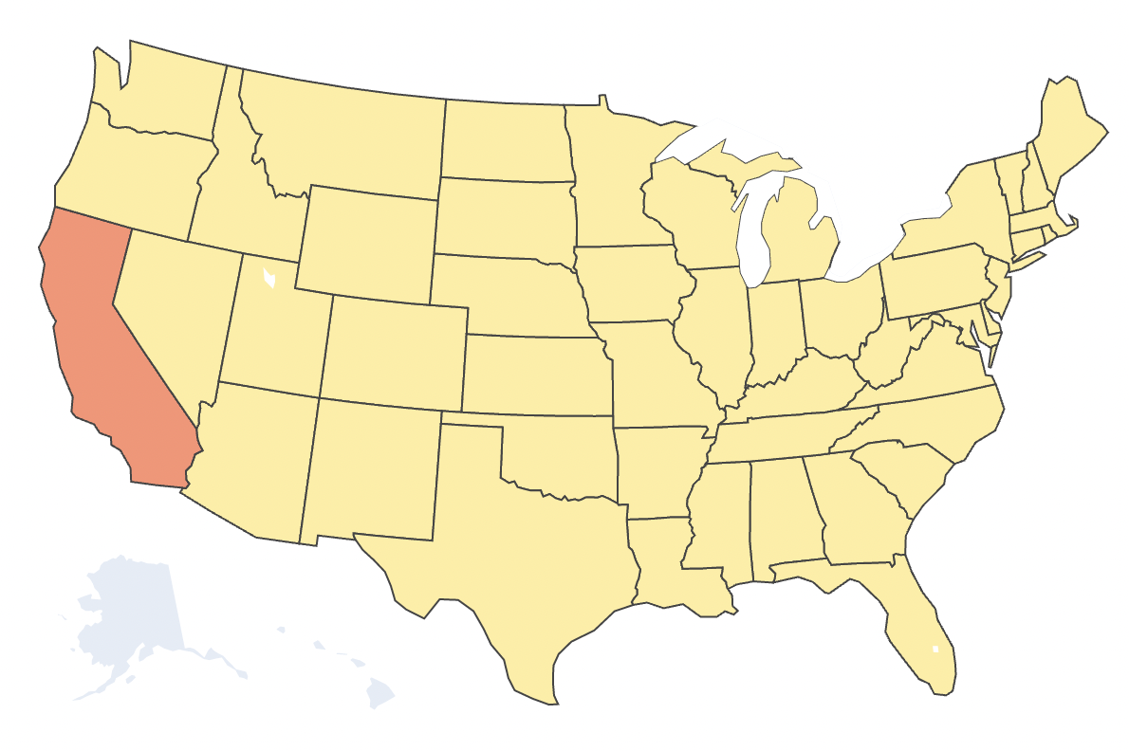
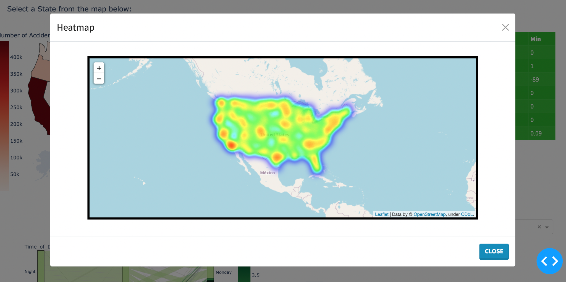
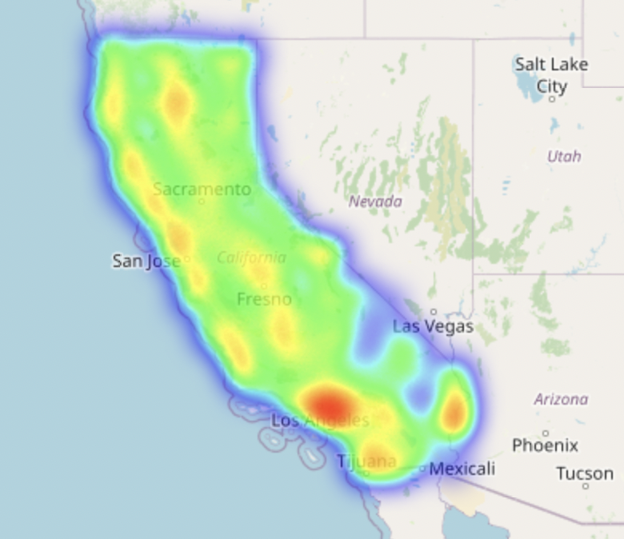
DASHBOARD WALKTHROUGH ( HEATMAP )
Notes:
Sources:
https://www.si.com/wnba/2021/08/26/womens-sports-growth-the-fan-project
https://www2.deloitte.com/xe/en/insights/industry/technology/technology-media-and-telecom-predictions/2021/womens-sports-revenue.html
https://www.un.org/womenwatch/daw/public/Women%20and%20Sport.pdf
https://www.hrw.org/report/2012/02/15/steps-devil/denial-womens-and-girls-rights-sport-saudi-arabia#
Rio 2016 U.S. Olympic Team (U.S. Gender Composition)
https://www.teamusa.org/road-to-rio-2016/team-usa/athletes
USC represented by 44 athletes — most of any U.S. university — at Rio Olympics
https://news.usc.edu/104898/usc-to-be-represented-by-43-athletes-most-of-any-u-s-university-at-rio-olympics/
USC wraps up Olympics with 21 medals, including nine golds
https://news.usc.edu/105935/usc-wraps-up-olympics-with-21-medals-including-nine-golds/

Slide 14
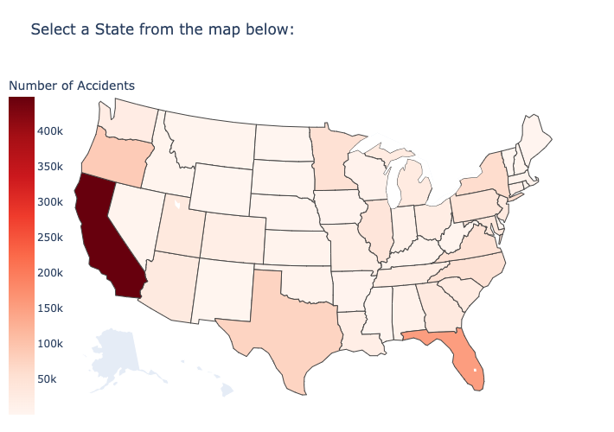
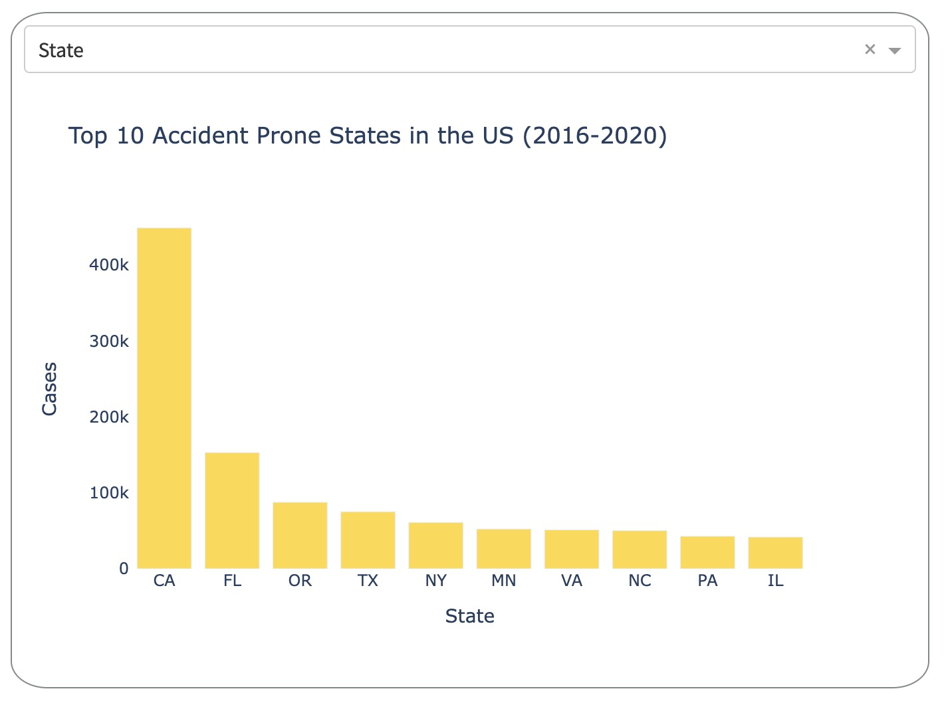
DASHBOARD WALKTHROUGH ( BARCHART )
Notes:
Sources:
https://www.si.com/wnba/2021/08/26/womens-sports-growth-the-fan-project
https://www2.deloitte.com/xe/en/insights/industry/technology/technology-media-and-telecom-predictions/2021/womens-sports-revenue.html
https://www.un.org/womenwatch/daw/public/Women%20and%20Sport.pdf
https://www.hrw.org/report/2012/02/15/steps-devil/denial-womens-and-girls-rights-sport-saudi-arabia#
Rio 2016 U.S. Olympic Team (U.S. Gender Composition)
https://www.teamusa.org/road-to-rio-2016/team-usa/athletes
USC represented by 44 athletes — most of any U.S. university — at Rio Olympics
https://news.usc.edu/104898/usc-to-be-represented-by-43-athletes-most-of-any-u-s-university-at-rio-olympics/
USC wraps up Olympics with 21 medals, including nine golds
https://news.usc.edu/105935/usc-wraps-up-olympics-with-21-medals-including-nine-golds/

Slide 15
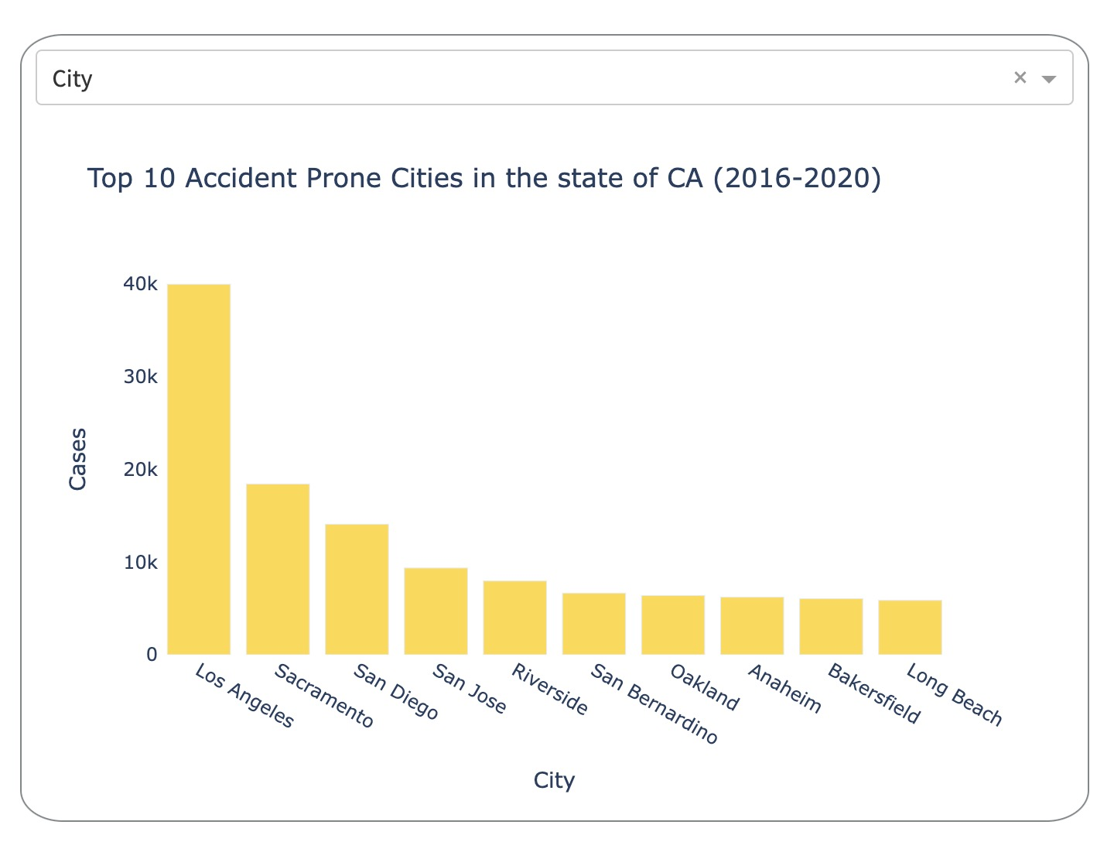
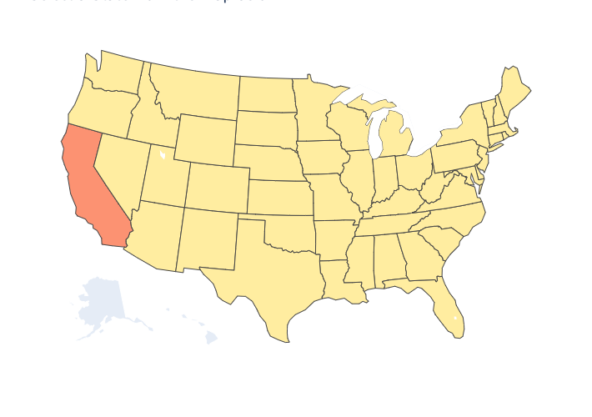
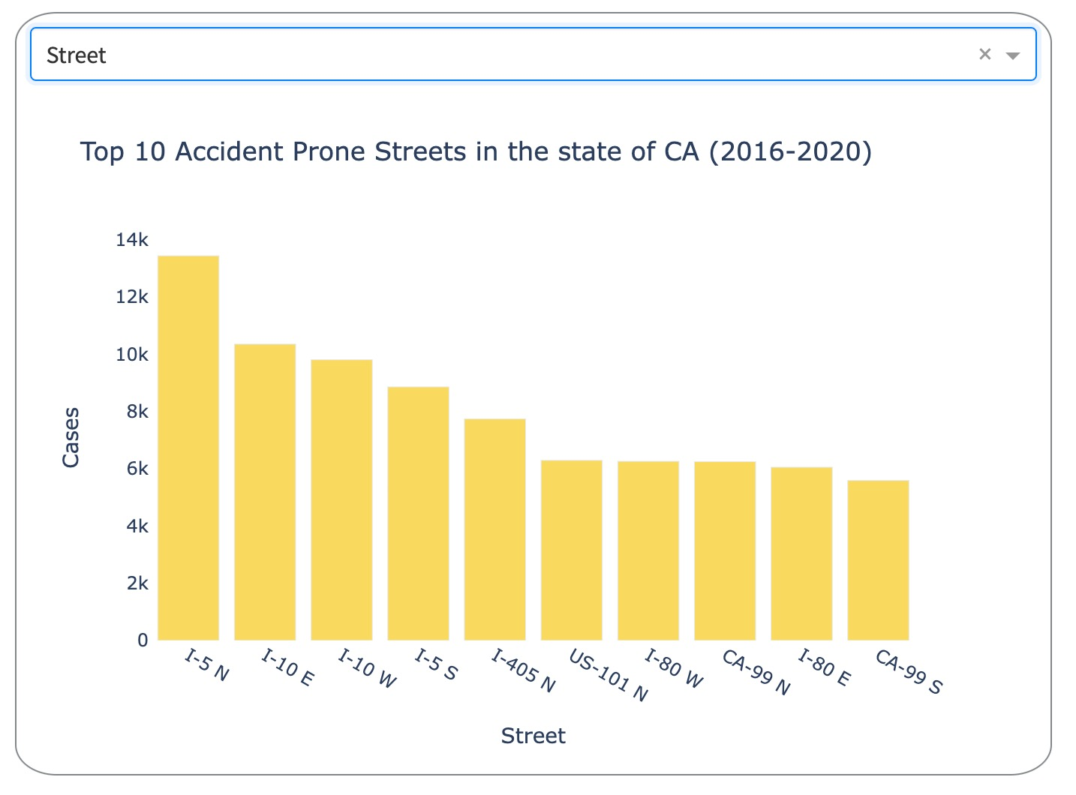
DASHBOARD WALKTHROUGH ( BARCHART )
Notes:
Sources:
https://www.si.com/wnba/2021/08/26/womens-sports-growth-the-fan-project
https://www2.deloitte.com/xe/en/insights/industry/technology/technology-media-and-telecom-predictions/2021/womens-sports-revenue.html
https://www.un.org/womenwatch/daw/public/Women%20and%20Sport.pdf
https://www.hrw.org/report/2012/02/15/steps-devil/denial-womens-and-girls-rights-sport-saudi-arabia#
Rio 2016 U.S. Olympic Team (U.S. Gender Composition)
https://www.teamusa.org/road-to-rio-2016/team-usa/athletes
USC represented by 44 athletes — most of any U.S. university — at Rio Olympics
https://news.usc.edu/104898/usc-to-be-represented-by-43-athletes-most-of-any-u-s-university-at-rio-olympics/
USC wraps up Olympics with 21 medals, including nine golds
https://news.usc.edu/105935/usc-wraps-up-olympics-with-21-medals-including-nine-golds/

Slide 16
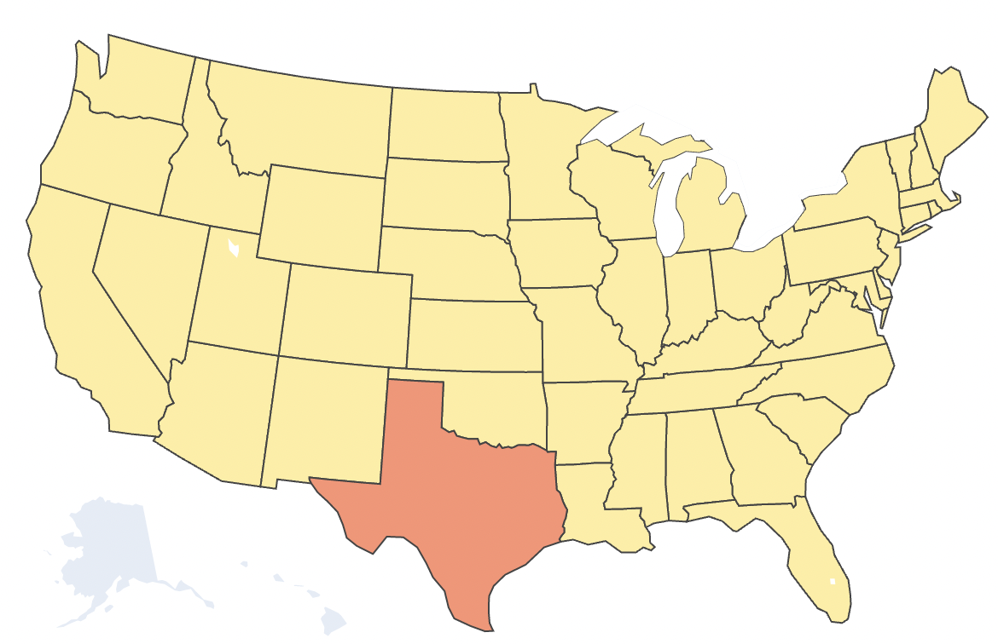
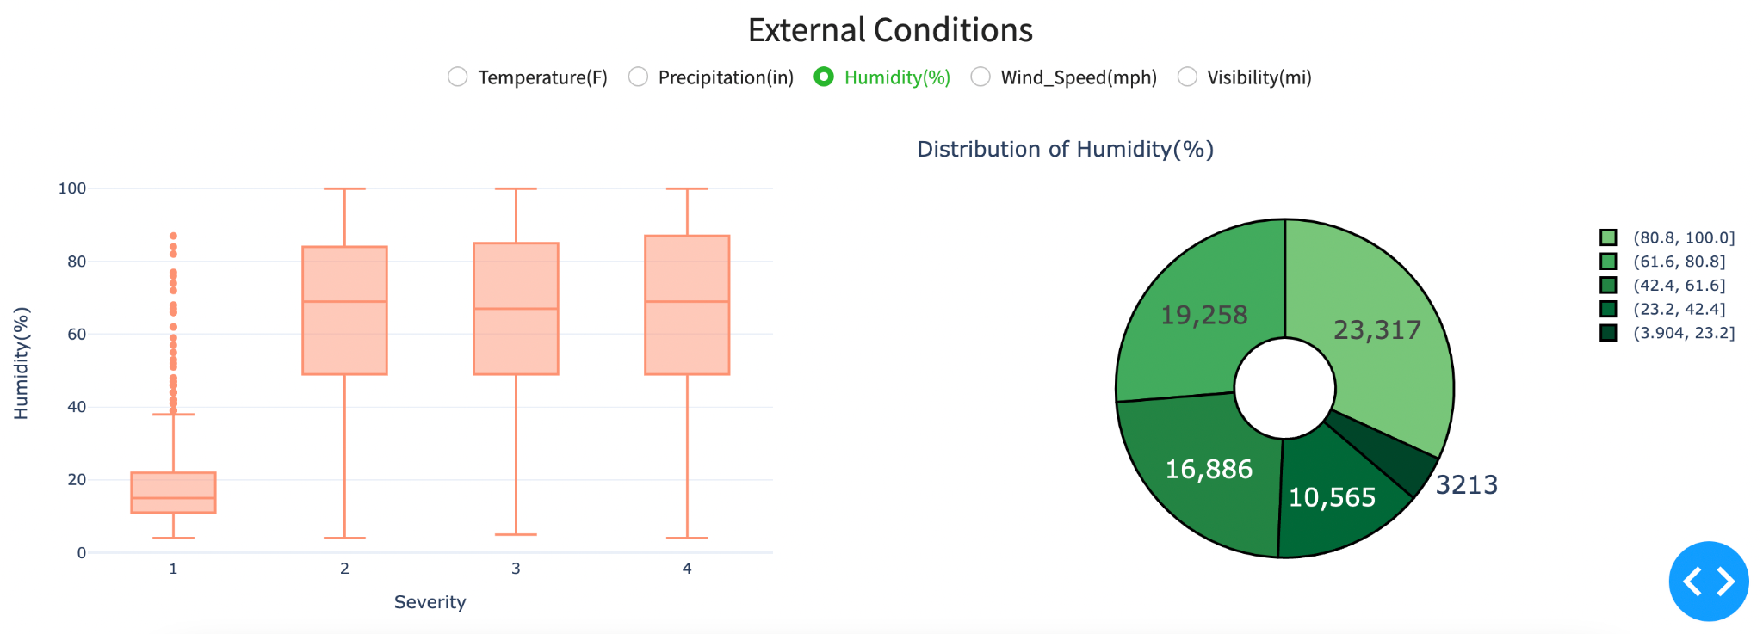
DASHBOARD WALKTHROUGH (BOXPLOT & PIE CHART)
Notes:
Sources:
https://www.si.com/wnba/2021/08/26/womens-sports-growth-the-fan-project
https://www2.deloitte.com/xe/en/insights/industry/technology/technology-media-and-telecom-predictions/2021/womens-sports-revenue.html
https://www.un.org/womenwatch/daw/public/Women%20and%20Sport.pdf
https://www.hrw.org/report/2012/02/15/steps-devil/denial-womens-and-girls-rights-sport-saudi-arabia#
Rio 2016 U.S. Olympic Team (U.S. Gender Composition)
https://www.teamusa.org/road-to-rio-2016/team-usa/athletes
USC represented by 44 athletes — most of any U.S. university — at Rio Olympics
https://news.usc.edu/104898/usc-to-be-represented-by-43-athletes-most-of-any-u-s-university-at-rio-olympics/
USC wraps up Olympics with 21 medals, including nine golds
https://news.usc.edu/105935/usc-wraps-up-olympics-with-21-medals-including-nine-golds/

Slide 17
REFERENCES
https://www.kaggle.com/sobhanmoosavi/us-accidents
https://plotly.com/python/statistical-charts/
http://ruraltransportation.org/mapping-10-years-of-fatal-traffic-accidents/
https://cdan.nhtsa.gov/tsftables/tsfar.htm#
https://www.trafficrus.co.nz/

Slide 18
APPENDIX
Temperature
Distribution looks fairly symmetrical with a mean of 59.58(F) and median of 61(F), std deviation of 18.27(F).
There is a slight hint of left skewness which could be confirmed with the skew value of -0.36 and the fact that Median > Mean.
The curve looks Mesokurtic and the same could be adjudged by the Kurtosis value of -0.08.
Range of Temperature is quite big, spans over -89(F) to +170(F).
Pressure
The distribution is heavily left skewed, the same is evident in the skew value of -3.47.
The curve is Leptokurtic, the values are more concentrated at the mean, Kurtosis is very high at 18.
Range spans from 0 - 58 atms.
Curve is Leptokurtic again, values are more concentrated at the mean.
Visibility
The distribution is right skewed with a skewness quotient of 4.1.
The curve is Leptokurtic, lot of values are concentrated at the mean, Kurtosis is extremely high at 100.
Range spans from 0 -140 miles.
Precipitation
The distribution is heavily skewed towards right
A mean and a median of 0.01 and 0.0 respectively confirms that the data is from a time frame when there was very little chances of rain.
Additional Packages required for dashboard
numerize: pip install numerize
folium: conda install -c conda-forge folium

Slide 19
Thank You!

